Slide 1
Welcome To My Presentation
Project on
Helicopter Game

Slide 2
Submitted by : Supervised by:
Name: Tanvir Hasan Name:Md. Jamal Uddin
Student ID:20131201027 Lecturer
Department of computer Department of Computer
Science & Engineering Science & Engineering

Slide 3
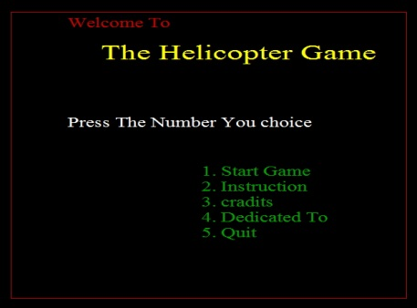
Introduction
The Helicopter Game is a most popular computer game. Actually I was very much addicted to the type of game in my child-hood. I just start work with graphics.h header recently. And it is my frist project. In this game the challenge for the player to save the helicopter.
It complicated with simple coding skill. I am try to develop it as possible by me. Using fundamental logic to implement it. The code is so easy to understand by any beginner programmer as me.

Slide 4
Implimentation Details
The total implementation of the game is huge. So for easy working and understanding, I divide the total code into some small function depending on there work.
My user defined functions are-
void initboard();
int key_hit();
void play();
void drow_board_GREEN();
void drow_board_init();
void drow_brick();
void clr_brick();
void score_board();
void score_board_clr();
int check_accident();

Slide 5
void p_clear();
void p_drow();
void hs();
void instruction();
void initial_bricks_ary();
void game_over();
void push_game();
void minimize_x_axis(int a[][3],int size);
void upper_brick(int x1,int rhi,int rx2,int rclor);
void upper_brick_clr(int x1,int rhi,int rx2,int new_endl);
void lower_brick(int x1,int rhi,int rx2,int rclor);
void lower_brick_clr(int x1,int rhi,int rx2,int new_endl);
void dedicated_to();
void cradit();

Slide 6
Related Work
DX-Ball
Snake
Ball-Bounch
Car Race

Slide 7
How it Works User Interface
I am designing the game as so easy to use it for user. What steps are need to do , user can see in the display. I use some common English words so that little learned man will easily play it.

Slide 8
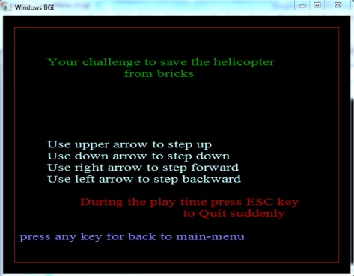
If user want to know that how to he/she can play the game. Then he/she need to choice option 2 and press button 2 then he/she can see that how to play the game. The window as like
fig : step 2
Now user need to press any button back to start page.
If user press any button then back to step 1

Slide 9
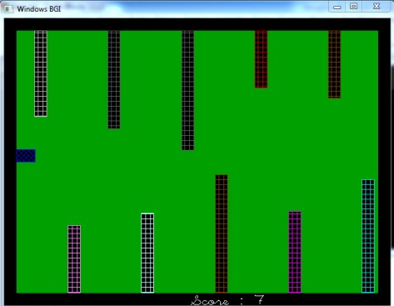
Starting Game
Now if user want to start the game, then he/she need to choice & press button 1.
Then the game will star.

Slide 10
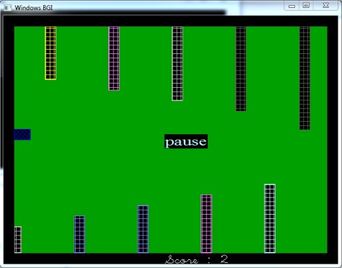
Pausing Game
User can pause game by press space.

Slide 11
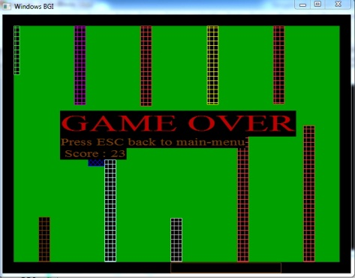
How game overs
If he/she make collision , then his/her game is over. He /she can back to main menu by pressing ESC button.

Slide 12
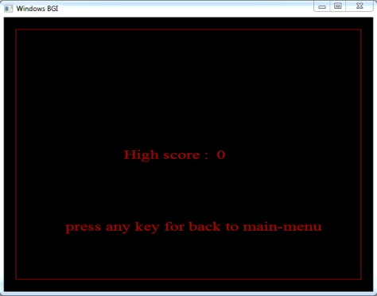
Showing High Score
Select option [3] for showing high score

Slide 13
Limitations
Here helicopter symbol by rectangle.
No use of high graphics
It is not 3D
It is not so attractive
It is a small game

Slide 14
Future Work
Make it high with graphics as reality
Convert to 3D
Include enemy helicopter & war

Slide 15
Discussion
It is specially helpful to students who needs to search for word’s meaning.
We can add,delete and see what are in dictionary library.
It is easy to as it is my first project and as I am at so beginner level at graphics.h world. I worked so hard to well implementation of my project. And I just do only it. It is in c language using graphics.h. I try to show to develop my skill. I feel better during the time when I worked for the project.
It is easy to play for all.
Its interface is user friendly. Hope it’ll be helpful to all.

Slide 16
Thanks All

